Slide 1
EASE 2021 PC Training
Paul Ralph
Dalhousie University
Notes:
Hi everybody and thank you for attending this training session. Reviewing is going to be a lot different this year so I’m going to walk you through the new process.
If you have any problems with the today's slides, you can find this presentation on the empirical standards github repo.
[click] The address is here at the bottom of every slide.
You’ll find a lot of other resources there, but we’ll get to that in due time.

Slide 2
Four Words
Fair
Inclusive
Transparent
Effective
Notes:
Our goal is to make peer review: fair, inclusive, transparent and effective.
Fairness means papers are treated the same. If your paper is rejected for some flaw, you don’t go to the conference and see some paper accepted with the same flaw.
Transparency means the authors know the criteria the reviewers will use to evaluate their papers. No surprises.
Inclusiveness means all valid approaches are welcome. No rejecting qualitative research because it doesn’t have any numbers
Effectiveness means the review process does, in fact, separate low quality studies from high-quality studies

Slide 3
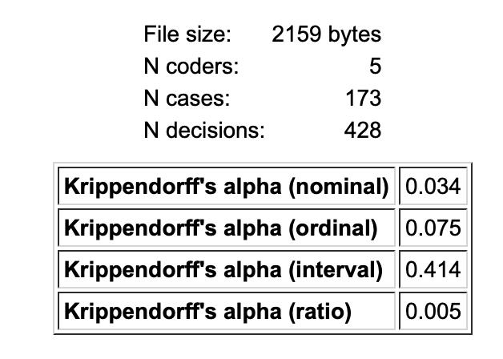
Inter-reviewer Agreement at EASE 2020
Krippendorff’s Alpha:
α ≥ 0.8: reliable
α ≥ 0.667: caution
α < 0.667 not reliable
Notes:
To reach any of these goals, we have to overcome Bug #1: modern peer review is mostly random. We can assess randomness in peer review using Krippendorff’s Alpha – a measure of inter-rater reliability. Basically, if alpha > 0.8, the review process is trustworthy. If alpha is between 0.667 and 0.8, the process is questionable. If alpha < 0.667, the data is not trustworthy and should not be used for any scientific purpose. So we calculated alpha for EASE 2020 and we get 0.075. This means peer review fails the basic test for reliable expert judgment: the experts can’t agree. In other words, peer review is mostly random. Not subjective. Not inconsistent. RANDOM. This is not an attack on last year’s PC – ALL software engineering conferences probably have similar numbers. I’m sorry if this makes you uncomfortable but we can’t do any better if we refuse to face reality. If we’re going to make peer review fair, transparent, inclusive and effective, first we’ve got to make it not random.

Slide 4

Evaluate Manuscript
Generate Rubric
Created by Vadim Solomakhin
from the Noun Project
Notes:
The reason peer review is random, is because, today, when a scholar peer reviews a manuscript, they must simultaneously generate and apply a set of evaluation criteria. Generating these criteria is really hard.

Slide 5
Reviewer 2
Rubric
Reviewer 1
Reviewer 3
Rubric
Rubric
Rubric
Rubric
Author
Editor
Notes:
So the reviewers, the editor, and the authors all construct different rubrics, and these rubrics may depart wildly from published methodological guidance, or the norms of our scientific community. This is why reviewers don’t agree and authors feel mistreated – everyone’s evaluating papers using different criteria. We need to use the same criteria.

Slide 6

Empirical Standards
Sampling
Engineering Research
Experiment
Case
Study
Systematic Review
Questionnaire
Grounded Theory
Data
Science
Simulation
Longitudinal
Software Engineering Community
Notes:
So the solution is for the software engineering community to decide together what “good” means. Furthermore, we can’t just have a single definition of "good" because SE has such rich methodological diversity. For example, our expectations for a controlled experiment are very different from our expectations for a case study. So we need to create different empirical standards for each common methodology. An Empirical Standard is basically a one-page checklist of specific expectations for a particular kind of study.

Slide 7
Contributors
Nauman bin Ali, BTH, Sweden [Quantitative Simulations]
Sebastian Baltes, University of Adelaide, Australia [Sampling]
Domenico Bianculli, University of Luxemburg [Engineering]
Jessica Diaz, Technical University of Madrid, Spain [IRR/IRA]
Yvonne Dittrich, IT University of Copenhagen, Denmark [Action Research]
Neil Ernst, University of Victoria, Canada [Pre-registration]
Michael Felderer, University of Innsbruck, Austria [Action Research, Case Study]
Robert Feldt, Chalmers University, Sweden [General]
Antonio Filieri, Imperial College London, UK [Engineering]
Breno Bernard Nicolau de França, University of Campinas, Brazil [Quantitative Simulations]
Carlo Alberto Furia, USI Lugano, Switzerland [Engineering]
Gregory Gay, Chalmers University / University of Gothenburg, Sweden [Optimization Studies]
Nicolas Gold, University College London, UK [Ethics]
Daniel Graziotin, University of Stuttgart, Germany [Open Science]
Pinjia He, ETH Zurich, Switzerland [General]
Rashina Hoda, Monash University, Australia [Grounded Theory]
Natalia Juristo, TU Madrid, Spain [Controlled Experiment]
Barbara Kitchenham, Keele University, UK [Systematic Reviews]
Valentina Lenarduzzi, LUT University, Finland [Longitudinal Studies]
Sira Vegas, TU Madrid, Spain [Controlled Experiment]
Jorge Martínez, Universidad Politécnica de Madrid, Spain [IRR/IRA]
Jorge Melegati, Free University of Bozen-Bolzano, Italy [Case Survey]
Daniel Mendez, BTH, Sweden, and fortiss GmbH, Germany [Questionnaire]
Tim Menzies, NC State University, USA [Exploratory Data Science; Optimization Studies]
Jefferson Molleri, Simula, Norway [Questionnaire]
Dietmar Pfahl, University of Tartu, Estonia [Quantitative Simulations]
Romain Robbes, Free University of Bozen-Bolzano, Italy [Data Science]
Daniel Russo, Aalborg University, Denmark [Longitudinal Studies]
Nyyti Saarimäki, Tampere University, Finland [Longitudinal Studies]
Federica Sarro, University College London, UK [Optimization]
Davide Taibi, Tampere University, Finland [Longitudinal Studies]
Janet Siegmund, Chemnitz University of Technology, Germany [Pre-registration]
Diomidis Spinellis, Athens University of Economics and Business, Greece [Systematic Reviews]
Miroslaw Staron, University of Gothenburg, Sweden [Action Research]
Klaas Stol, University College Cork, Ireland [Case Study]
Margaret-Anne (Peggy) Storey, University of Victoria, Canada [Multimethodology and Mixed Methods]
Davide Taibi, Tampere University, Finland [Longitudinal Studies]
Damian Tamburri, Eindhoven University of Technology, Netherlands [Case Study; Exploratory Data Science]
Marco Torchiano, Polytechnic University of Turin, Italy [Information Visualization, Questionnaire]
Christoph Treude, University of Adelaide, Australia [Grounded Theory]
Burak Turhan, Monash University, Australia [Controlled Experiment]
Xiaofeng Wang, Free University of Bozen-Bolzano, Italy [Case Survey]
Notes:
So, in 2018, I assembled a task force of some of the to create Empirical Standards for Software Engineering Research. Over 40 of the best methodological experts in software engineering drafted 14 standards and 7 supplements for cross-cutting concerns. Since the initial drafts, we’ve been accepting suggestions and improvements from the community at large. You can find all the standards and supplements on the GutHub Repo. There’s loads of good information there.

Slide 8
Your two options
Old
Detailed review on Easychair
Read Paper
Read Paper
Complete Checklist
Upload Checklist
Brief Review on Easychair
New
Notes:
The empirical standards help us design a better review process. You don’t have to use the new process if you don’t want to. You can just read the paper and fill out the form on Easychair. But you won’t be helping us improve the reliability of the review process.
Alternatively, you can try the new process I’m about to describe. It’s going to seem a bit overwhelming but everyone who’s tried this says you get used to it quickly and then it’s faster and better.

Slide 9
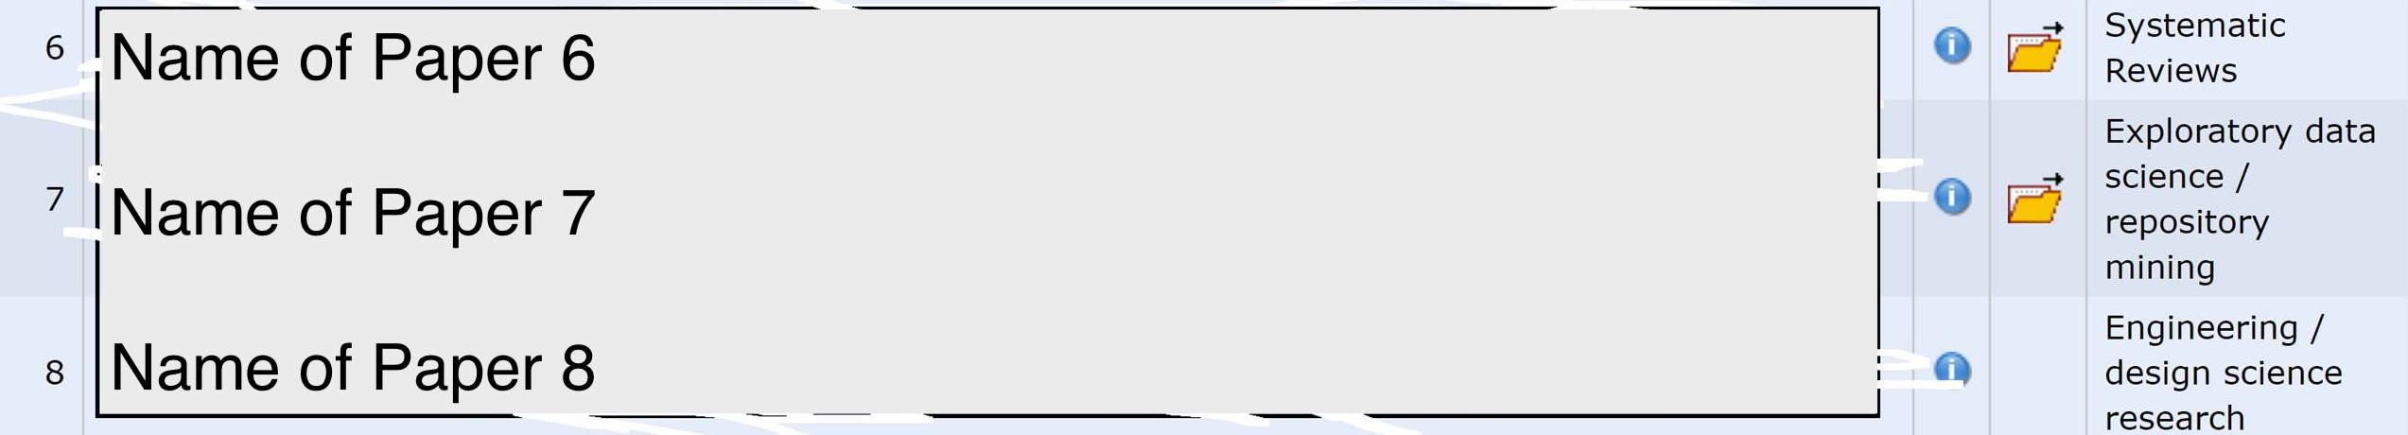
List of Papers
Author’s method selection
Notes:
First, you go on Easychair and get your review assignment. Open up you first paper and take note of the research method indicated by the authors.

Slide 10


Review Checklist Generator
https://web.cs.dal.ca/SIGSOFT-Empirical-Standards/
Notes:
Next, head over to the review checklist generator at this address. Now this is a prototype so please be patient with it and let me know if it breaks.
Click on “Generate a review checklist for EASE 2021”
90% of the time you just select the method the author indicated and click submit. If you’re not sure what to pick, you can:
You can mouse-over each method for a brief definition.
If that’s not enough, you can click on the method and go to the standard (Click Quesitonnaire). The application section [here] explains more about where the standard applies and disambiguates related methods.
If you’re still not sure, reach out to me for guidance. [back]
Some of these terms may be unfamiliar, so few notes are in order.
If the paper proposes and assesses a new tool or technique, click “engineering research” AND the method of assessment. So if the paper proposes a tool and tests it using an experiment with human participants, we click both Engineering Research and Experiment.
If the manuscript reports two different kinds of studies that address the same research questions(s), choose multimethodology or mixed-methods study, select Multimethodology and both methods. For example, we might have a case study and a questionnaire survey.
Data science refers to data-centric predictive modeling, not just quantitative description. Some papers might be marked “exploratory data science or repo mining”. You’ll have to use some judgment here. If there’s no predictive modeling, it’s not data science.
If the paper is about research methods, like it provides guidelines for doing research, click “meta-science”
If the paper talks about “experiments” but there’s no humans involved, it’s probably a quantitative simulation.
If the paper is a basically a bunch of interviews it’s either grounded theory or a qualitative survey. GT papers usually say they used GT explicitly.
Systematic literature review includes mapping studies.
If the paper does not report an empirical study (like an opinion paper) or uses a method not listed here, you can’t use this tool. You’ve just got to review it the old fashioned way.
Let’s suppose we’re reviewing a questionnaire survey. [click and submit]
We need to focus on the essential attributes. The first 15 criteria you see here are from the general standard [highlight]. You will see these no matter what you pick because they apply to all empirical studies. Some criteria have links to supplements (like the sampling supplement here) or tooltips (here) that give further details. Next come the specific criteria for the research method selected [highlight].
The idea here is to read the paper with the checklist upon the screen. As you read the paper, you tick off all the essential criteria. (ignore desirable and extraordinary for now). Most of this should be really straightforward: The paper states a research question [click]; states a motivations [click], etc. defines key concepts; etc. This doesn’t mean that you like the RQ or that the motivation is good. It’s just there.
If you click ‘yes’ to all the essential criteria, accept the paper. We’re not weighing strengths and weaknesses here. If the paper has all essential attributes, accept the paper.
Now suppose you get down to “explains handling of missing data” and realize the paper doesn’t do that. We call that a deviation. Whenever you encounter a deviation, you, as an expert reviewer, have to decide whether that deviation is reasonable in the context of this specific paper. If you think the deviation is reasonable, then it’s fine. If you think one or more deviations are unreasonable, reject the paper unless the fix is trivial. An example of a trivial fix would be adding a missed limitation, rewriting a paragraph, adding a measure of effect size, etc. Anything that can be done in a few hours.
Once you’ve decided to accept the paper, skim the desirable and extraordinary criteria and tick off any that apply. If you tick a bunch, consider nominating the manuscript for a best paper award.
When you’re done, print the page to .pdf and head back to easychair.

Slide 11
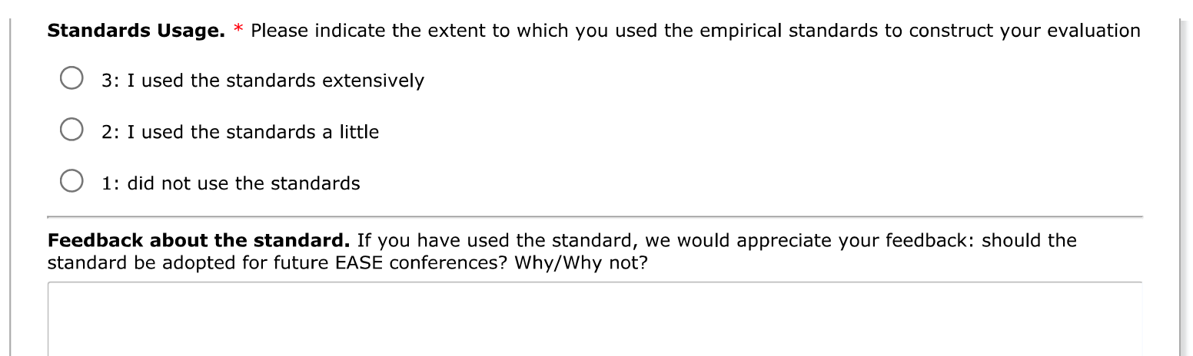
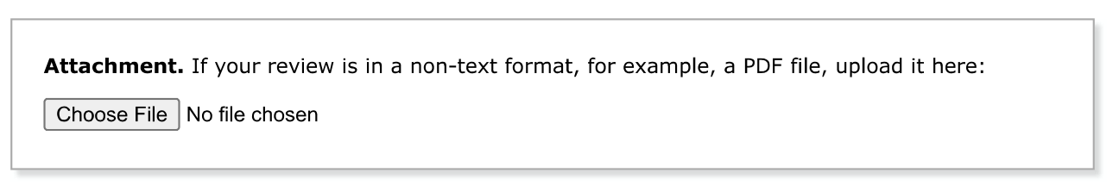
Notes:
If you scroll all the way to the bottom of your review form, you’ll see that the file attachment button that’s always there but none of us ever use. Please upload the PDF of your checklist here. Then head back up to the top of the page…

Slide 12
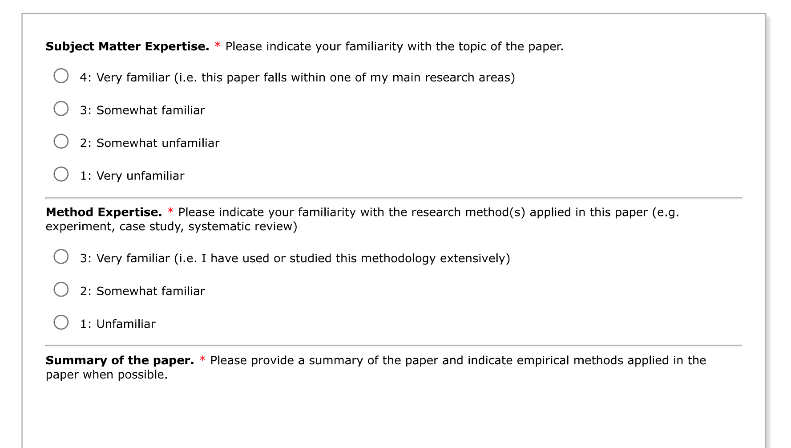
Notes:
We’re you’ll see the usual questions about your expertise, a summary of the paper….

Slide 13
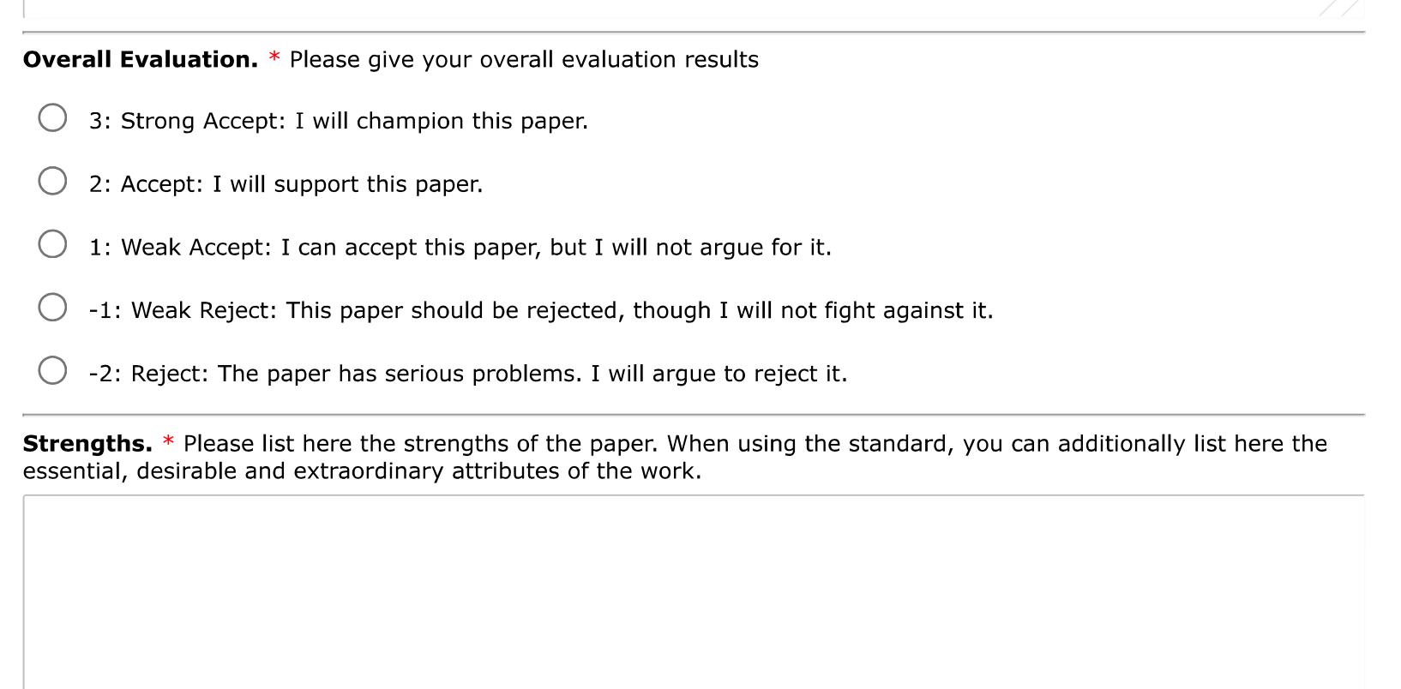
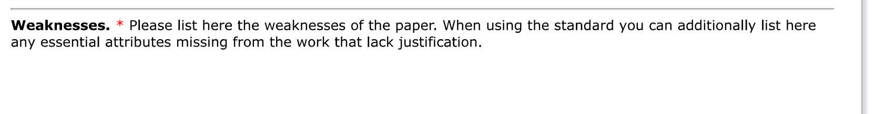
Notes:
And the decision. The checklist basically tells you the decision. If there are unreasonable deviations from the standards you reject. Otherwise accept. You shouldn’t really need the “weak accept” or “weak reject” unless there’s a deviation and you’re not sure if it’s reasonable or not.
You don’t have to write much in strengths or weaknesses because it’s all in the pdf. If you want, you can list some desirable attributes under strengths and some deviations under weaknesses, or you can just write “see pdf”.

Slide 14
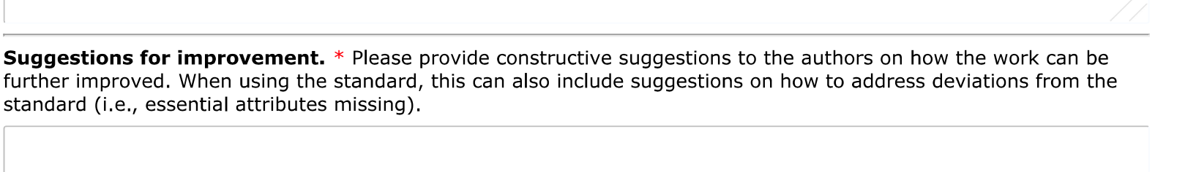
Report issues here
Notes:
Under suggestions for improvement, discuss deviations from the standards, if any and your recommendations for fixing them. If there aren’t any deviations, you can offer other friendly suggestions. You don’t need to write a 500 word essay here. If you’re rejecting a questionnaire survey because it doesn’t explain how missing data is handled, you don’t have to explain what that means or why it’s important. It’s important because it’s an essential criteria in a standards-based review process.
Do NOT introduce new criticisms that aren’t based on the standards. If reviewers bring in their own criteria that aren’t in the standards, the whole project falls apart and we go back to making each other miserable.
If you feel that there’s something fundamentally wrong with a paper that is not captured by any of the relevant standards, you can ask me about it, or go to the repo and lodge an issue, BUT THEN ACCEPT THE PAPER ANYWAY. We’ve basically told the authors their work will be assessed against these specific standards. We can’t bring up new stuff.
You don’t have to agree with everything in all of the standards. *I* don’t agree with everything in the standards. Stick to them anyway. I know this is hard. But we as reviewers have to accept that our role is to enforce our community’s expectations, not our individual expectations, so that we as authors can our papers reviewed fairly, inclusively, transparently and effectively.
That doesn’t mean you can’t change the standards. The standards are created and maintained by the SE community, which you are a part of. If there’s something wrong with the standards, you can suggest a fix. We’re just not going to change them in the middle of the review process.

Slide 15
Empirical Standards Repository
https://github.com/acmsigsoft/EmpiricalStandards
Notes:
Let’s have a look at the repo where you can find more resources.
There’s a readme, an FAQ, a license, and some info about contributing and how to cite the standards, as you’d expect
The Empirical Standards Report [here] explains a lot more about how we build the standards, why we did it that way and how to use them.
You can use the issues feature [here] to report and problems with the standards, or if you’re familiar with github you can do a pull request to fix things directly.
The supplements are in the “supplements” directory
The Standards are in the “docs” directory
You don’t have to read all the standards but you should look at the general standard. I’m just going to highlight a few things:
By asking you to review a paper, the program chairs are basically saying that they think the paper is within the scope of EASE, so try not to worry about scope.
If you realize you have a conflict of interest or insufficient expertise to review, please let the program chairs know
If you’re not sure how to interpret an attribute, like what does “contributes to the collective body of knowledge” mean, you can ask me. I’m here to help with interpretation, but I’m not going to tell you whether to accept or reject a specific paper. That’s the program chairs’ job.
Under General Quality Criteria: “there are no universal quality criteria”. Don’t apply stuff from one philosophical perspective to another, like don’t apply internal validity to a postmodern ethnography.
Under good review practices: “state their own limitations and biases.” You’re not going to undermine the review process by admitting your set theory’s a little rusty, just like research papers don’t undermine science by admitting their limitations.
Please read through the invalid criticisms and reviewing antipatterns.
Don’t play “gotcha” with the standards. Don’t look for a deviation so you can reject a paper. Each time you find a deviation, think about whether it’s reasonable.
Don’t reject a paper because there’s no standard for that method. Just do an old-fashioned review.
Read, don’t skim.
Try to be specific, technical and detailed-oriented without copyediting and nitpicking. Rejecting a study because it used inappropriate statistical procedures is “detailed-oriented”, rejecting a paper because it has spelling mistakes is nitpicking.
Don’t use the review process to push authors to cite your own work. I don’t care how relevant it is. It creates a conflict of interest. If you think it’s relevant, put it in the confidential comments to the PC.
[back] We’re not going through all of these today. I just want to show you one thing.
[Data Science] -> Acceptable Deviations
Most standards have examples acceptable deviations. In data science, for example:
We want the data set in a replication package, but if the data can’t be shared, that’s ok
If you have longitudinal data we want you analyze it in a longitudinal way, but maybe it’s not practical to model it as time series
If you’re struggling with whether a deviation is acceptable, try opening the standard and read some of the example deviations.
Most standards also have a list of invalid criticisms
Do not make any of these criticisms. If you see other reviewers making these criticisms, politely tell them in the discussion that it’s one of the invalid criticisms listed in the standards.
For example, do not reject a data science paper just because the findings are not immediately actionable to participants.
Don’t reject a data science paper because it doesn’t have qualitative data; don’t reject a case study because it doesn’t have any quantitative data
More common invalid criticisms include:
There exists a paper that is relevant but not referenced. You can recommend references but this is not grounds for rejection no matter how relevant the paper, especially if YOU wrote it.
Hypotheses not supported
The paper is not framed, positioned or motivated well (don’t like the intro).

Slide 16
Summary
Get a paper from Easychair
Generate and complete review checklist
Base your decision on the standards
Ask for help if you need help
Report an issues on the repo
Don't impose non-standard criteria
Checklist->PDF->Easychair
Notes:
To summarize:
Grab a paper from easychair
Open up the checklist generator
If you can’t find the right method, ask me for help or do an old-fashioned review
If the method is there, complete the checklist and upload the pdf to easychar
Fill out the review form. Base your decision on the checklist. Briefly explain your decision.
Do not reject papers for reasons other than those described in the relevant standards
If you find any problems with the checklist generator or the standards, please report them on the repo so we can fix them.
Questions?

